Slide 1


2019
Department
Of Computer
Science
&
Electrical And
Electronics
Engineering
MATH-IV
KAS -402
2020-2021
Dr.Rupa Sharma
Associate Professor
vsrsrsys@gmail.com

Slide 2
UNIT 1 PARTiAl differential equation

Slide 3
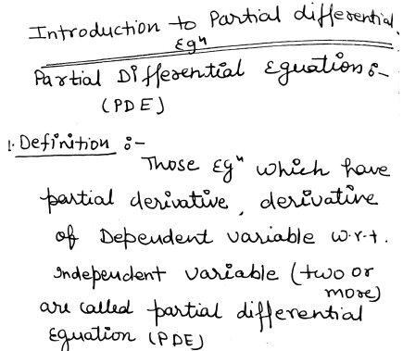
Topic 1

Slide 4
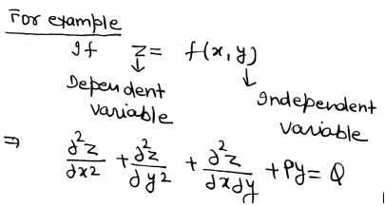
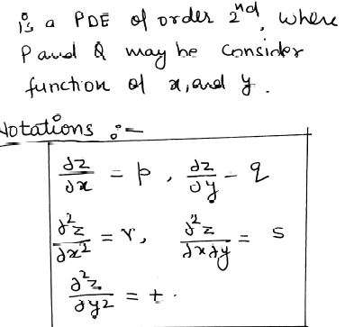

Slide 5
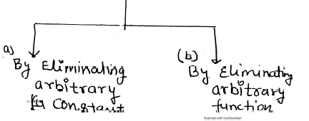
Formation of pde

Slide 6
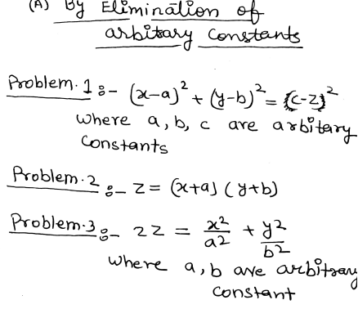
some problem s

Slide 7
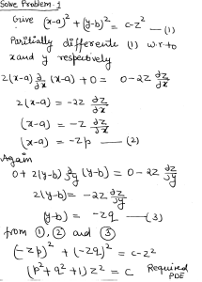
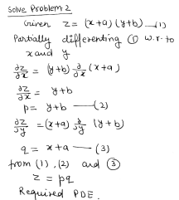
Solution of problems

Slide 8
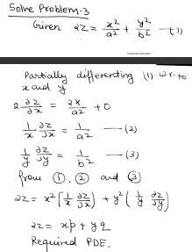

Slide 9

HOME work

Slide 10
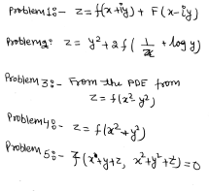
Solve problem By Elimination of arbitrary function

Slide 11

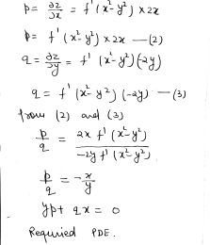

Slide 12
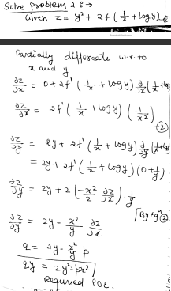

Slide 13

HOME WORK

Slide 14
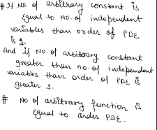
Remark

Slide 15
THANK YOU

